Slide 1
Physical Sample day 1 Notes

Slide 2
Steve - There are 4-5 broad areas to start discussing
Sampling/sub-sampling process we want to navigate from any parts including transformed parts back to where they came from
:A sub-sample isDerivedFrom PhysicalSample
Parts explosion which is related to the sub-sampling process
Identify registration which binds the identity to the sample object via some identifier scheme that can be dereferenced to get the phusical object as well as information about the physical sample telling what the "object means".
Sample properties
But there is also the issue of the object called collection (not the collection process).

Slide 3
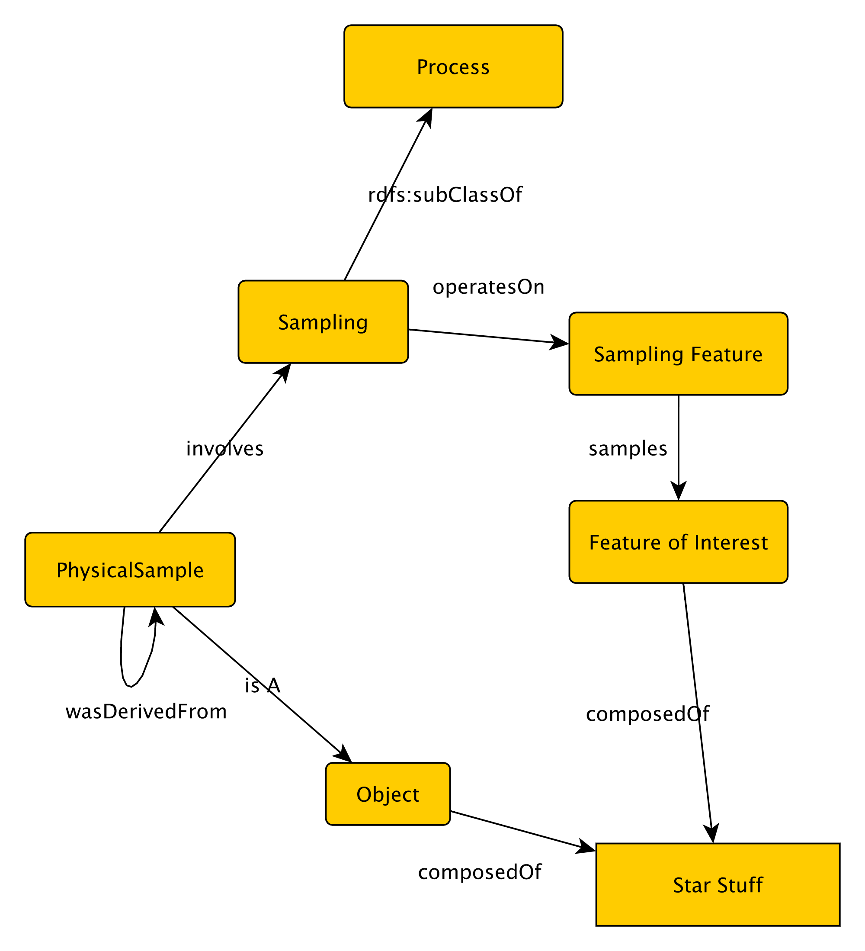
Conceptual Model in Progress

Slide 4
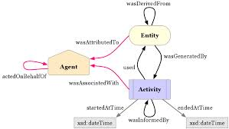
We think that we can handle some of the issues involved in sub-sample and intentions using Prov-O
hasProperties to note?
For sub-samples
wasInfluencedby
Was DerivedFrom....
Has ID and location to note
hasProperties to note?
We want location of activity and methods/instruments used

